Slide 1
Lesson 2
CAN Basic Frame
Date
Notes:
1) Xin chao moi nguoi, cam on moi nguoi da tham gia vao khoa hoc FuSa
Buoi hom nay la ve phan session 1, overview ve FuSa
2) Truoc em cung gui tai lieu ve FuSa, anh chi em thay the nao.
Tai lieu co de hieu khong ah, cam giac FuSa co de khong ah.
3) Em xin phep buoi nay nhu chia se kien thuc, kinh Nghiem ve FuSa.
Cac anh chi em da co kinh Nghiem lau nam, nen neu co gi khiem khuyet xin cac anh chi em dai xa cho

Slide 2
Contents
CAN frame Types
CAN Standard Data Frame Format
CAN Extended Frame Format

Slide 3
Types of CAN Frames
CAN protocol has 4 types of frames.
Data Frame
Remote Frame
Error Frame
Overload Frame

Slide 4
Data Frame
Frame carrying the data from transmitter node to all receiver nodes.
Serves the main purpose of CAN protocol
Two types of Data Frames
  Standard Frame : 11 bit message ID
  Extended Frame : 29 bit message ID {split as 11 bit Base ID + 18 bit ID Extension}
In CAN when we are normally talking of frames, we are referring Data frames only.

Slide 5
Remote Frame
Frame Requesting for a Data Frame
A node wants a particular Data frame, so It sends the Remote frame with same Message ID on the Bus.
This remote frame is followed by the Data frame on the bus transmitted by the node who owns that data frame.
Hence Remote frame sending node got the data it requested for.
Now a days Remote frame is obsolete and not used in CAN protocol.

Slide 6
Error Frame
Error Frame signals an error condition in the data frame being transmitted currently.
If a node detects an error in the data frame being transmitted on the bus currently, then it destroys that data frame and signals all other nodes by transmitting a error frame.
The error can be detected by any of the receiver nodes or the transmitter node.

Slide 7
Overload Frame
Overload frame is transmitted by a node when it is overloaded and needs some time to process the data frame received previously.
Overload frame format is same as that of an error frame.
Strategy is that since the overloaded node needs some time so it buys that time by keeping the bus busy with its overload frame preventing other nodes to start transmitting data frames.
Maximum of 3 consecutive overload frames can be transmitted by each node after a data frame.
Transmission of an Overload Frame is started during the first 2 bits of the IFS of the preceding frame

Slide 8
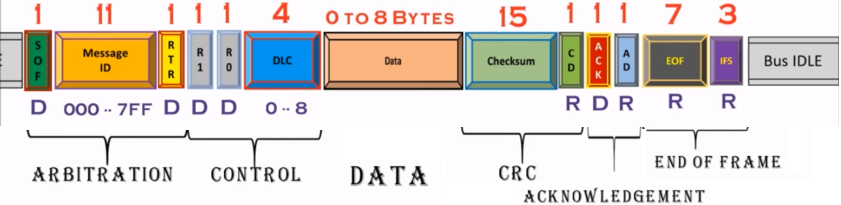
CAN STANDARD DATA
FRAME FORMAT

Slide 9
IDLE = Recessive state
11 bit Message ID: 0x000 ~ 0xFFF
RTR (Remote Transmit Request)
  R = 1 = Remote Frame
  D = 0 = Data Frame

Slide 10
R1:reserve for IDE(Identifiy Extension for differentiate Standard and Extended Frame)
  IDE = 1 (R): Extended Frame
  IDE = 0 (D): Standard Frame
R0:reserve for future

Slide 11
DLC(Data length code): Tells how many bytes of data is there in this frame

Slide 12
Checksum (CRC): CAN uses BCH (Bose–Chaudhuri–Hocquenghem) method to compute checksum
CD (Checksum Delimiter): always recessive

Slide 13
ACK (Acknowledgement slot):
  Tx node pút a Recessive bit in ACK,
  All Rx Nodes who wants to acknowledge the frame will put Dominat bit in ACK slot
AD (Acknowledgement Delimiter): always recessive

Slide 14
EOF (End of Frame): 7 Recessive bits
IFS (Inter Frame Spacing): Separate two Consecutive frames from each other, no transmission is allowed during IFS

Slide 15
Extended Frame Format
AGENDA
Why Extended Frame
Extended Frame format
Additional bits for Extended frame

Slide 16
Why Extended Frame
CAN is a message based protocol
We know with standard frame format the message ID being 11 bits we can have maximum of 2048 frames per network.
In real time scenario, this number is not always sufficient.
So a extended frame format was proposed where the message ID is 29 bit long.
IN a network both Standard CAN and extended CAN frames can co-exist.
These frames are differentiated by a new bit called as IDE.

Slide 17
Standard Format: 11 Bit Message Identifier
Extended Format: 29 Bit Message Identifier

Slide 18
Additional Bits
SRR: Substitute Remote Request → In place of RTR bit in Standard frame format.
Always Recessive and single bit
IDE: Identifier Extension Indication Bit → Indicates the presence of Extended Identifier or not and hence differentiates Standard frame and extended frame.
Dominant (0): Standard frame
Recessive (1): Extended frame

Slide 19
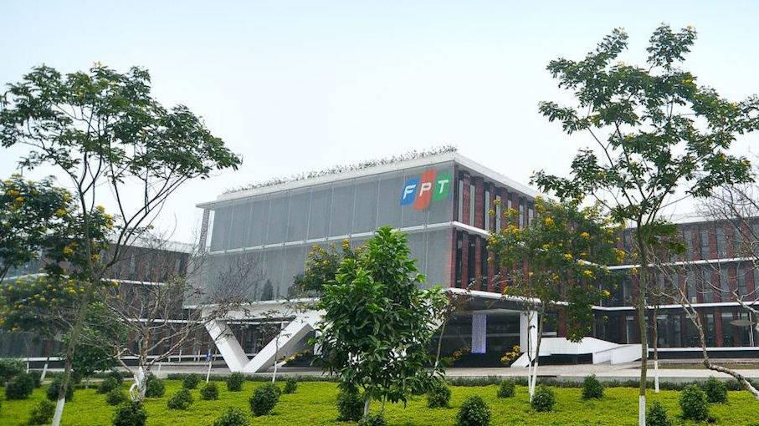


THANK YOU

